Slide 1
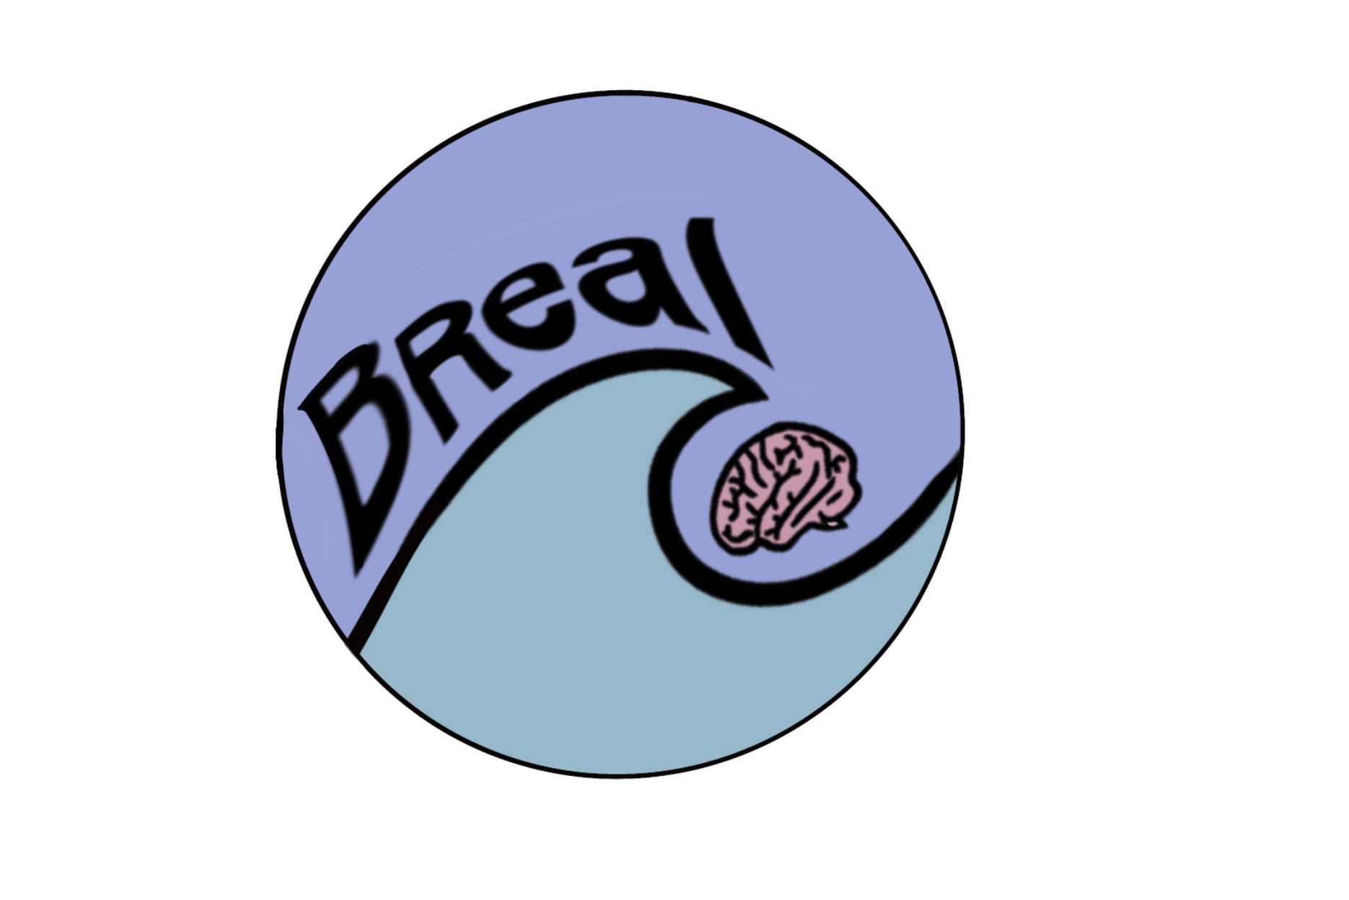
Building stress resilience
in early adolescents' lives (BReal)
Your child's class is currently doing a three-lesson programme on the neuroscience of stress and learning skills to deal with it.
To help you support their learning at home, here are some suggested conversation starters for you and your child to each share your answers to:
How does your body feel when you're stressed?
What do you do when you feel stressed? Does it help?
How does it feel when you make mistakes?
What could you try differently next time you are stressed?
How can you help your friends when they feel stressed?
To find out more about this programme and the team of researchers who developed it, go to:
https://www.win.ox.ac.uk/about/engaging-for-impact/public-engagement/current-projects/breal-building-stress-resilience-in-early-adolescents-lives

